Slide 1
LECTURE 2
Concentration by magnetic
EXTRACTIVE METALLURGY- FIRST CLASS
FERROUS EXTRACTIVE METALLURGY
separation: Magnetic separation
technology plays an important role in upgrading (improving) low-grade iron ores because magnetic separators possess (have) the combined advantages of large capacity and low operating cost and being

Slide 2

environmentally friendly. For more
EXTRACTIVE METALLURGY- FIRST CLASS
FERROUS EXTRACTIVE METALLURGY
info, visit
MAGNETIC SEPARATION.mp4
Principle of magnetic Separation
Magnetic separation is based on
differences in magnetic properties of
the ore components. Figure 1 shows that when a magnet is placed close to an iron ball and a ceramic ball, the iron ball will be attracted to the magnet and the ceramic ball will not.

Slide 3
Figure 1 shows that when a magnet
EXTRACTIVE METALLURGY- FIRST CLASS
FERROUS EXTRACTIVE METALLURGY
placed close to a group of mixed tiny
iron and ceramic balls, most iron balls will be attracted to it, but most
ceramic balls will not.
The balls that are not attracted will fall due to gravity. In this way, countless (numerous) different mineral particles can be separated by magnetic
separators. Here, the magnetic force

Slide 4

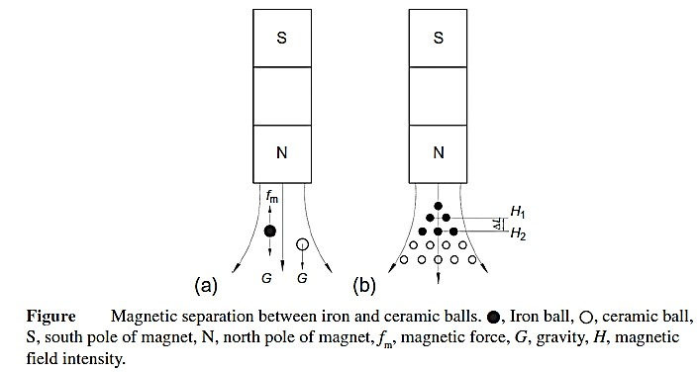
and gravity are the two competing
EXTRACTIVE METALLURGY- FIRST CLASS
FERROUS EXTRACTIVE METALLURGY
forces. If the magnetic force acting on
a particle is stronger than the gravitational force, the particle will
move toward the magnet.

Slide 5
Agglomerations Techniques (Particles Enlargement)
EXTRACTIVE METALLURGY- FIRST CLASS
FERROUS EXTRACTIVE METALLURGY
The feed to a blast furnace should
form a permeable (penetrable) bed of material, permitting gas to flow
through it uniformly at a high rate. Ground iron ore concentrates are not suitable in their as-produced form, both because fine particles tend to pack into a non-permeable bed and because the fine particles are likely to

Slide 6
be carried away as dust by the high gas
EXTRACTIVE METALLURGY- FIRST CLASS
FERROUS EXTRACTIVE METALLURGY
flow rates. The powdered ore must
therefore be agglomerated (enlarged) into larger particles that will improve
permeability of the furnace burden, increase the rate of extraction, and reduce the amount of material blown out (carried out) of the furnace as dust. There are four basic methods that have been developed for

Slide 7
agglomerating iron ores: sintering,
EXTRACTIVE METALLURGY- FIRST CLASS
FERROUS EXTRACTIVE METALLURGY
nodulizing, briquetting, and
pelletizing. These processes are briefly described below
Sintering
The sintering process consists of
combining iron-bearing fine particles with a solid fuel and igniting (burning) the mixture at high temperature. As the fuel burns, the temperature in the

Slide 8
bed increases to about 1300 ⁰C to 1480
EXTRACTIVE METALLURGY- FIRST CLASS
FERROUS EXTRACTIVE METALLURGY
⁰C, sintering the fine particles into a
porous (permeable) material that is suitable for use as blast furnace feed.
The bonding between the particles is by recrystallization and partial melting, and so no additional binder needs to be added in this process. Sinter performs well in the blast furnace, particularly if it is made with

Slide 9
fluxes added before sintering and
EXTRACTIVE METALLURGY- FIRST CLASS
FERROUS EXTRACTIVE METALLURGY
sized to 2mm_6mm before charging
to the furnace. Because the sinter product is subject to breakage and
abrasion during handling, this process is mostly used for processing ores from mines that are very close to the blast furnace operation.
Nodulizing

Slide 10
Like sintering, nodulizing does not
EXTRACTIVE METALLURGY- FIRST CLASS
FERROUS EXTRACTIVE METALLURGY
require the addition of binders. The
process works by charging iron- bearing fine particles to a rotary
furnace and heating to the point of initial melting. As the charge is dropped in the furnace, it forms into nodules (nodes) that are bonded together by the liquified portion of the partially melted fines. The process

Slide 11
does have a few advantages, such as
EXTRACTIVE METALLURGY- FIRST CLASS
FERROUS EXTRACTIVE METALLURGY
insensitivity to feed moisture and
particle size and high strength of the nodules; however, its disadvantages of
high fuel consumption, operating and control difficulties and nonuniform nodule size have tended to make this process uncompetitive, and it is no longer used.
Visit
Agglomeration Process in English.mp4

